Slide 1
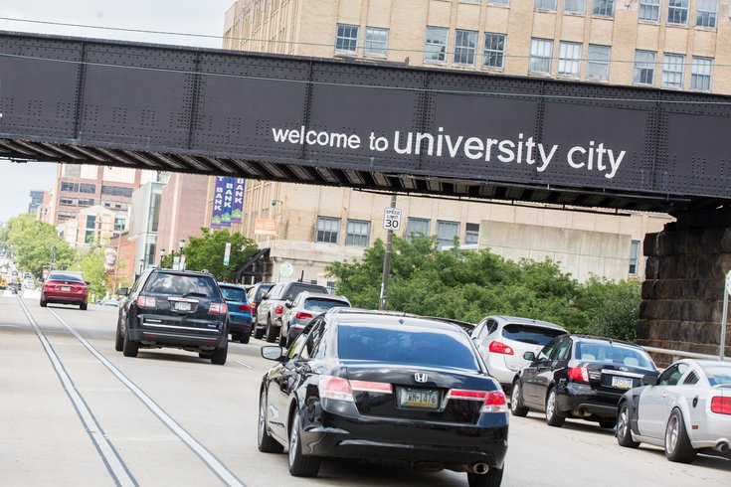


Slide 2
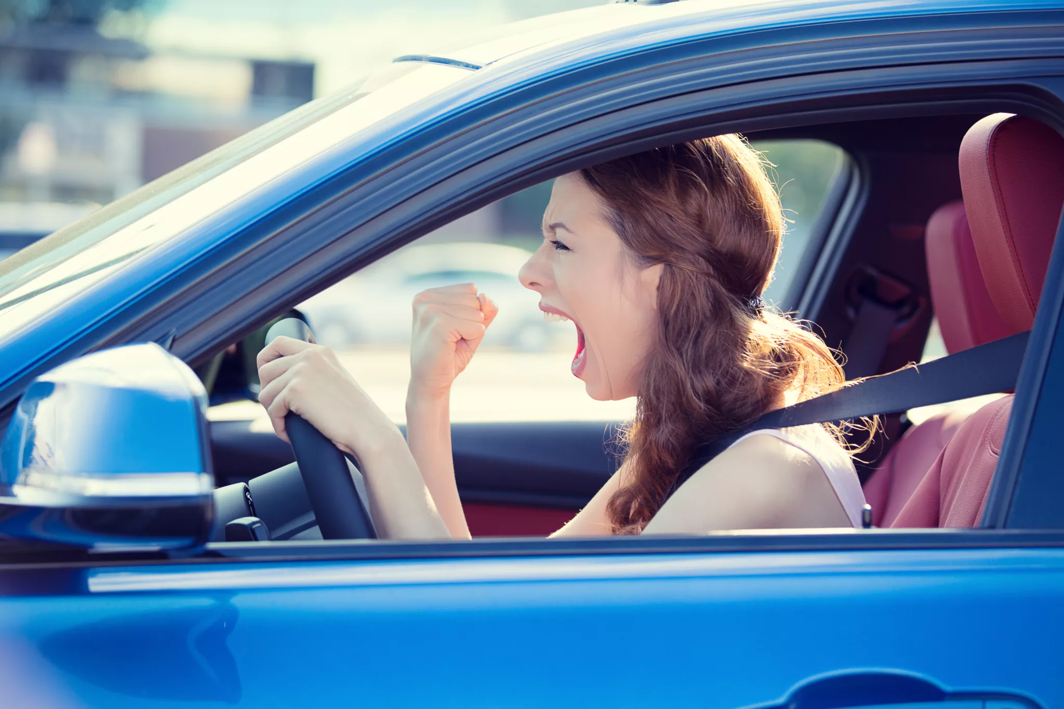

Slide 3


Commuting
Work
Commuting Problems
Commuting
Time
Unpredictability
Job Control
Workload
Time Pressure
Spillover
Impact on Performance
Strains
Satisfaction
Calderwood, C, Mitropoulos, T. Commuting spillover: A systematic review and agenda for research. J Organ Behav. 2021; 42: 162– 187. https://doi.org/10.1002/job.2462

Slide 4

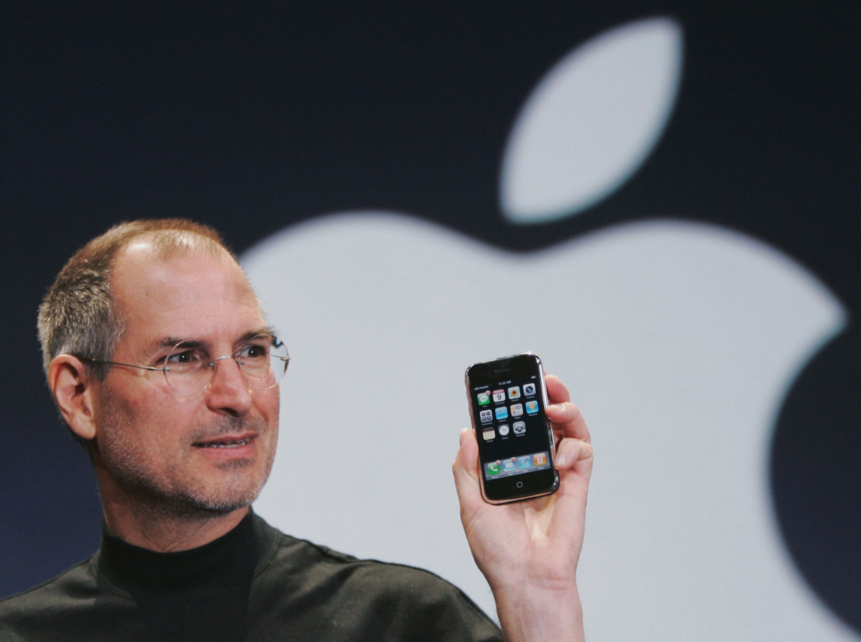

Tinder for Parking??

Slide 5

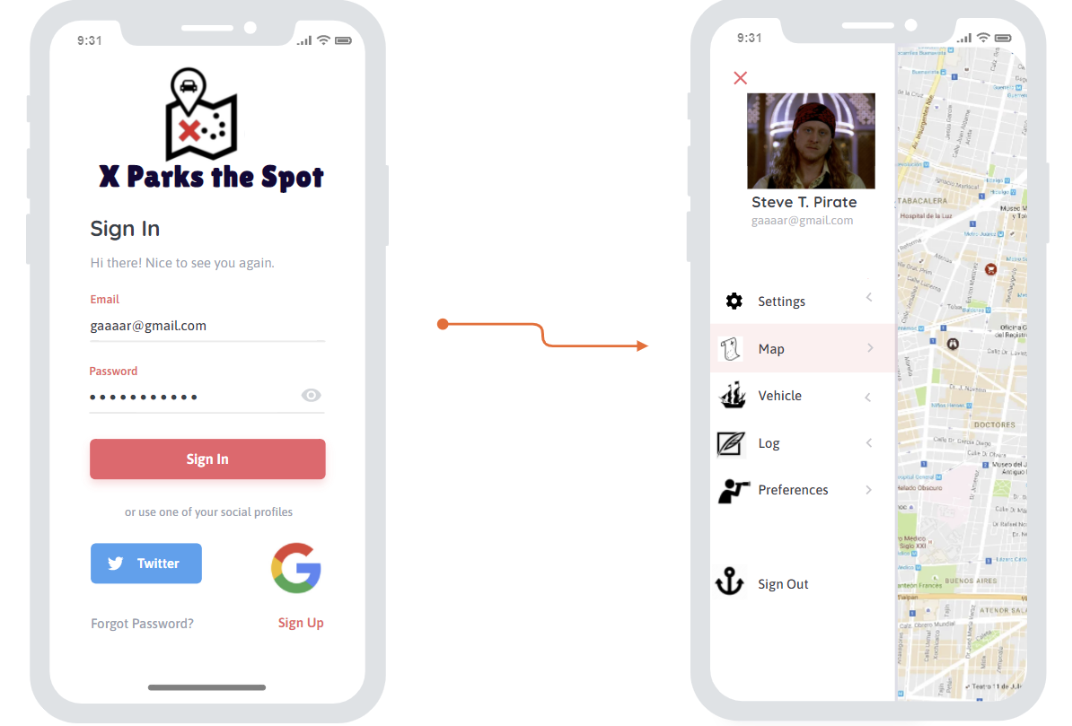

“Mapping the Uncertain-Sea of Parking”

Slide 6
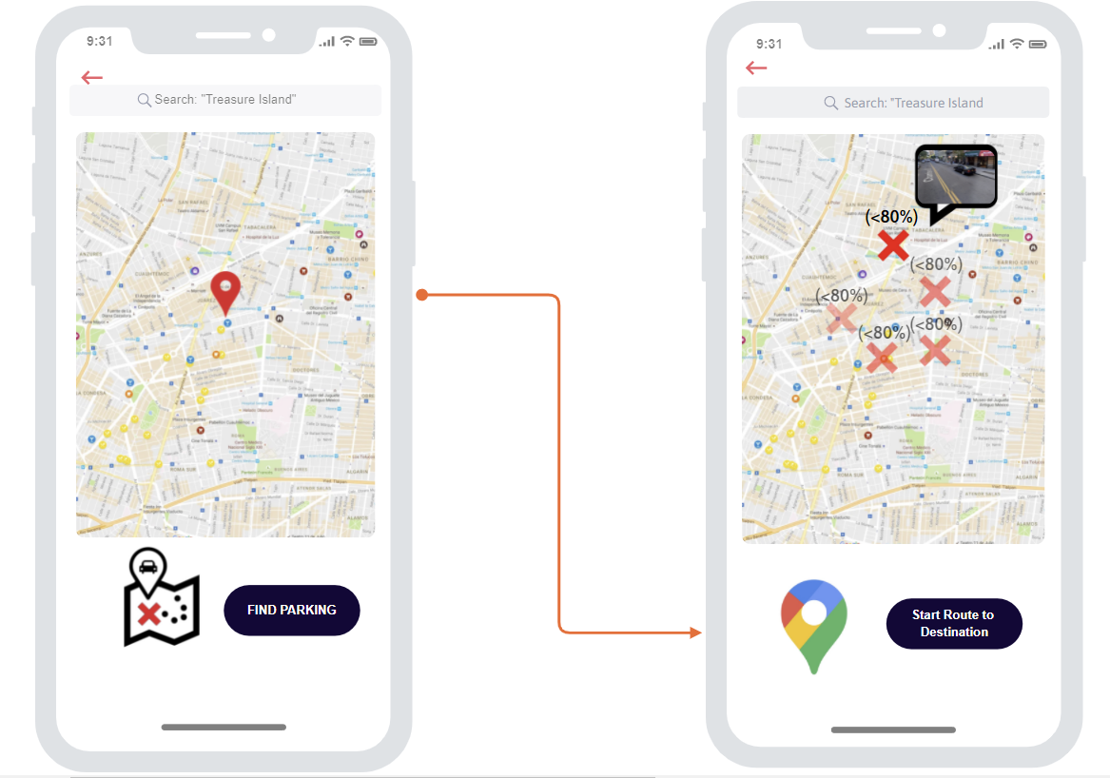



Slide 7
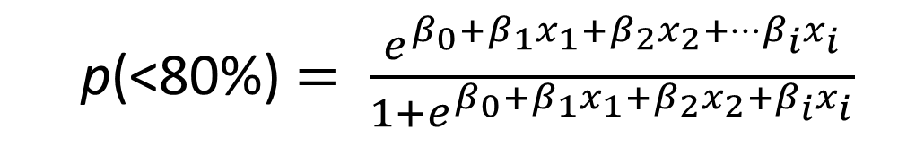
71%
The Logisitic Algorithm
p(<80%) $= \frac{e^{β_{0}+β_{1}x_{1}+β_{2}x_{2}+…β_{i}x_{i}}}{1+e^{β_{0}+β_{1}x_{1}+β_{2}x_{2}+β_{i}x_{i}}}$
< 80% of parking spaces on a street block are occupied
80%

Slide 8

SFMTA variables
Census Variables
Occupancy Rates
Spatial
Temporal
Location
Dynamic Prices
Time parked
Work Commuters
Vehicle Ownership
Driving Population
Tract Characteristics

Slide 9
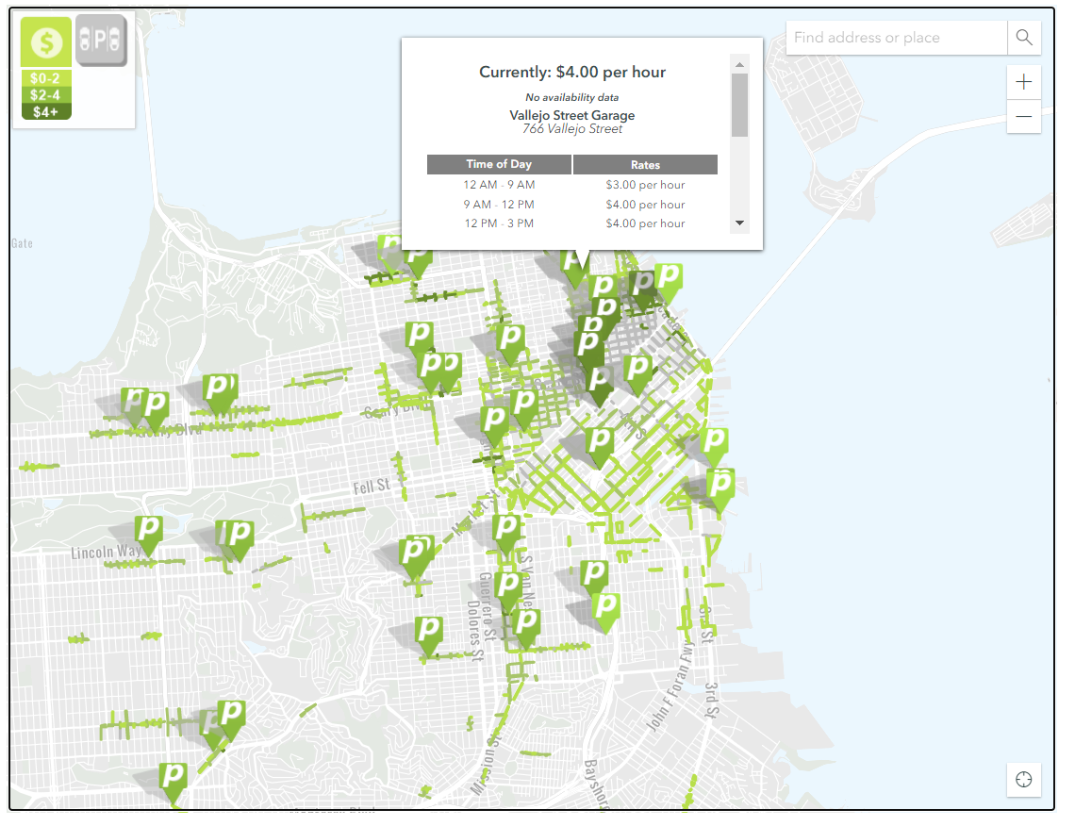
SF Dynamic Pricing
INCREASES RATE by $0.25 on blocks where average occupancy is
> 80%
DECREASE RATE $0.25 on blocks where average occupancy is < 60%
No Change to rate - Occupancy between 60% and 80%.

Slide 10
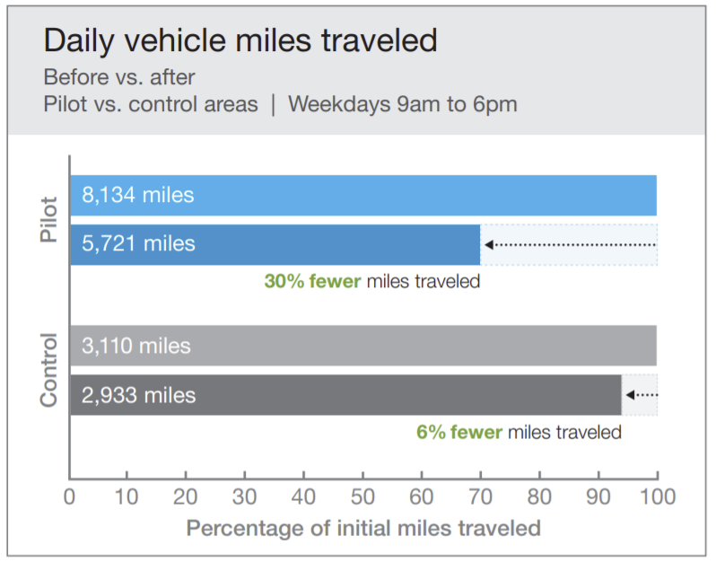
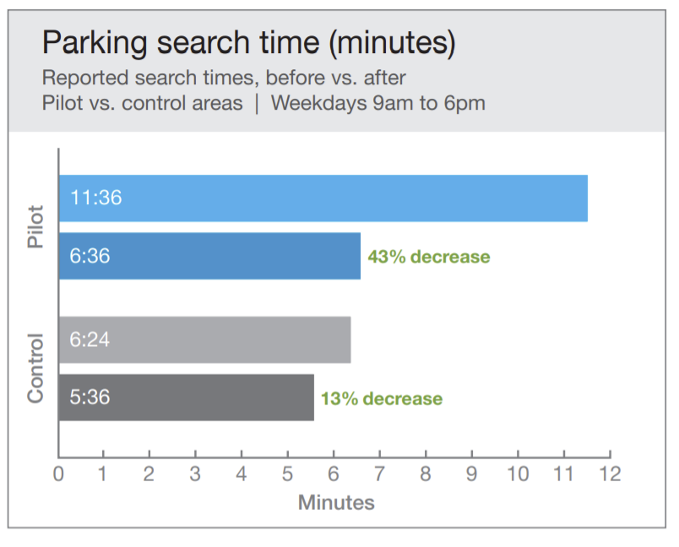

Slide 11
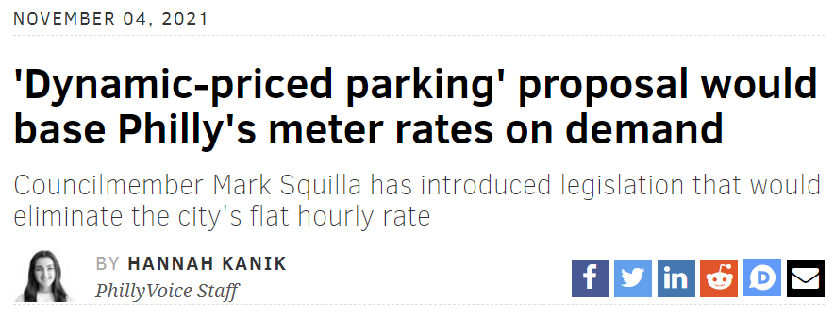



Slide 12

Mapping the Uncertain-Sea of Future Parking
“However, these models also suggest that drivers did not respond instantaneously to price changes during the pilot. The existence of these lags implies that more precise communication of price may reduce lag‐time in driver responsiveness by communicating information more quickly. Such communication could come in the form of a consumer‐facing internet and phone application showing pricing information and perhaps occupancy estimations.” – pg. 32-33
Fichman, Michael. (2016). An Evaluation of Pittsburgh's Dynamically‐Priced Curb Parking Pilot. 10.13140/RG.2.2.16274.25289.

